Slide 1
Climate Change and Sentiments Analysis – Literature Review
by AKSHAY KAUSHAL

Slide 2
Agenda
1
Article 1 review
A 43-Million-Person Investigation into Weather and Expressed Sentiment in a Changing Climate
2
Article 2 review
Climate Change Sentiment on Twitter: An Unsolicited Public Opinion Poll
3
Article 3 review
Sentiment Analysis of Shared Tweets on Global Warming on Twitter with Data Mining Methods: A Case Study on Turkish Language
4
Additional Terms/Papers/Ideas/Perspectives
5
Data Sources & APIs

Slide 3
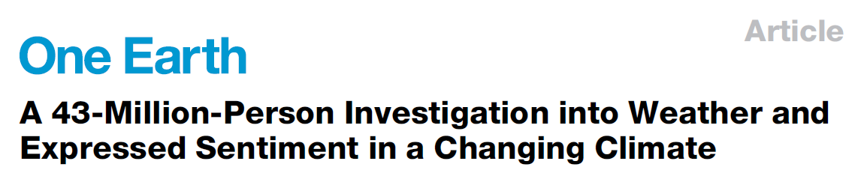
1
Objectives:
1. Do daily temperatures alter expressed Chinese sentiment in ways that mirror the effect of temperatures on sentiment from other world regions?
2. Does the effect of weather on sentiment vary by seasons, by individual gender, or by city-level characteristics?
3. Do adaptation strategies designed to cope with very cold and hot temperatures effectively mitigate the effects of extreme temperatures on sentiment?
4. How might climate-change-induced warming alter future Chinese sentiment?

Slide 4
1
Data:
1. Meteorological data from the National Meteorological Information Center of China, which releases station-day level data for daily mean temperature, daily maximum temperature, daily minimum temperature, daily mean humidity, daily precipitation, daily mean wind speed, daily sunshine hours, and daily cloud cover for 821 stations across China from 1970 to the present
2. 400m geotagged social media posts across 43m users in 121 cities in China (from the largest Chinese microblog platform, Weibo [Chinese Twitter]) over the whole year of 2014
3. NASA’s NEX-GDDP dataset (https://cds.nccs.nasa.gov/nex-gddp/) composed of downscaled global climate scenarios. Each of the climate projections includes daily maximum temperature, minimum temperature, and precipitation for the periods from 1950 through 2100. The spatial resolution of the dataset is 0.25◦ (25 x 25 km).

Slide 5
1
Method (1/2):
Employed a fixed-effects panel regression approach. Combined aggregated city-level sentiment index with daily meteorological data
Baseline model Dependent variable: City-level measure of sentiment in city i in province p on day t in year-month m.
Baseline model Independent variable: maximum temperature (Tmax, measured in degrees Celsius), daily mean temperature, Tmean;
Modeled the variable by using indicator variables for each 5◦C bin. Such temperature bins allow for flexible estimation of the relationship between temperature and expressed sentiment.
Omitted the 20◦C–25◦C for Tmax (and 15◦C–20◦C for Tmean) category in binned regression, and therefore the coefficients of interest could be interpreted as the effect on the sentiment change relative to the 20◦C–25◦C baseline.
Also examined the marginal effects of temperature range, percentage cloud cover, precipitation, relative humidity, and PM2.5 concentration

Slide 6
1
Method (2/2):
Sentiment analysis approach:
Used the Boson Chinese NLP platform (http://bosonnlp.com/), a machine-trained sentiment analysis algorithm from computational linguistics, to measure sentiment.
This platform provides a professional Chinese sentiment analysis API that aims to determine the attitude, opinion, or emotion of a user with respect to some topic or overall contextual polarity of a text.
For a Weibo post, the sentiment analysis extracts Chinese characters (excluding numbers, English characters, punctuations, URLs, hashtags, and mentions), constructs Chinese word segmentations, and obtains the sentiment scores of these word segments from the dictionary, which contains sentiment scores of Chinese-language words.
It returns a label representing the identified sentiment, along with a numerical score ranging from a strongly positive mood (1.0) to an extremely negative mood (0.0)

Slide 7
1
Results and/or Projections:
Extreme weather worsens emotional expressions on social media.
Females and individuals in poorer cities are more affected by extreme temperatures.
Seasonal resilience is increased in regions with centralized winter heating but is unaffected by the prevalence of air conditioning in summer.
Climate change is likely to worsen daily Chinese sentiment by 0.3%–2.1% over the course of this century, especially in northern and central China.
Data and Code Availability:
Language – R
Link - http://doi.org/10.17605/OSF.IO/TSG4K.

Slide 8

2
Objective:
To provide a general exploration of the sentiment surrounding tweets containing the word “climate” in response to natural disasters and climate change news and events.
Data:
1.5m tweets containing the word “climate” from Twitter’s gardenhose API (a random 10% of all messages) during the roughly 6 year period spanning September 14, 2008 through July 14, 2014
A reference set of roughly 100bn tweets from which the climate-related tweets were filtered

Slide 9
2
Method:
Apply the hedonometer to the climate tweets during different time periods and compare them to the reference set
Hedonometer: Dodds et al. developed the “hedonometer”, a tool for measuring expressed happiness - pos and neg sentiment - in large-scale text corpora
Since its development, the hedonometer has been implemented in studies involving the happiness of cities and states, the happiness of the English language as a whole, and the relationship between individuals’ happiness and that of those they connect with etc.
Word Shift graphs: To show which words contributed most to the shift in happiness between climate tweets and unfiltered tweets

Slide 10
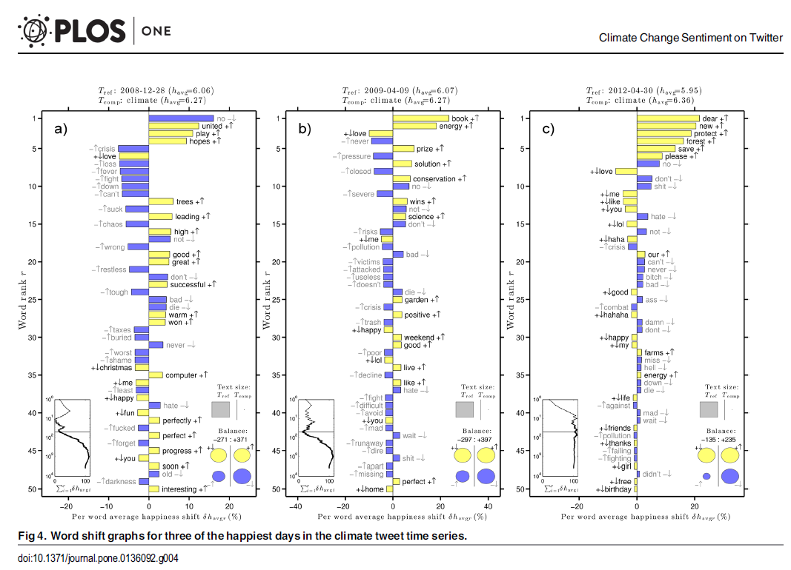

Slide 11
2
Results and/or Projections:
We find that natural disasters, climate bills, and oil drilling can contribute to a decrease in happiness, while
climate rallies, a book release, and a green ideas contest can contribute to an increase in happiness
Words uncovered by our analysis suggest that responses to climate change news are predominately from climate change activists rather than climate change deniers, indicating that Twitter is a valuable resource for the spread of climate change awareness.
Data and Code Availability:
Coding material, couldn’t find
Data – links to downloadable ZIP files available for word frequency vectors by day in .csv format

Slide 12
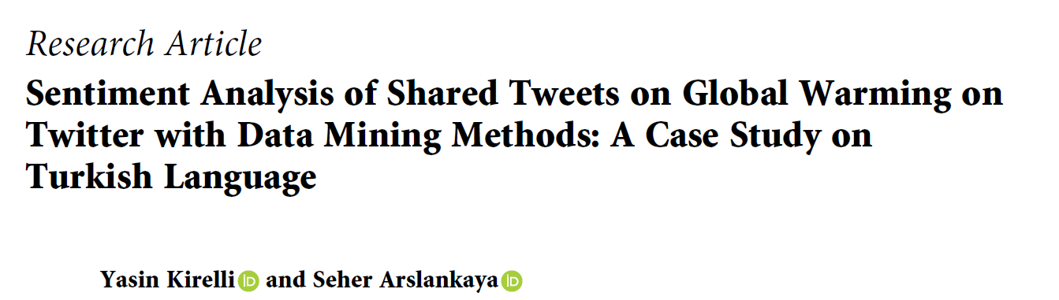
3
Objective:
To conduct Sentiment analysis of Turkish tweets about global warming and climate change by using machine learning methods
To use algorithms that are determined by supervised methods (linear classifiers and probabilistic classifiers) and compare their performance ratios
To provide benchmarking results for future sentiment analysis studies on Turkish texts
Data:
848 tweets (Twitter API) in Turkish with selected hashtags used as test set
16000 positive and 16000 negative tweets are produced and classified beforehand in Hayran et al.’s study and are used as training dataset

Slide 13
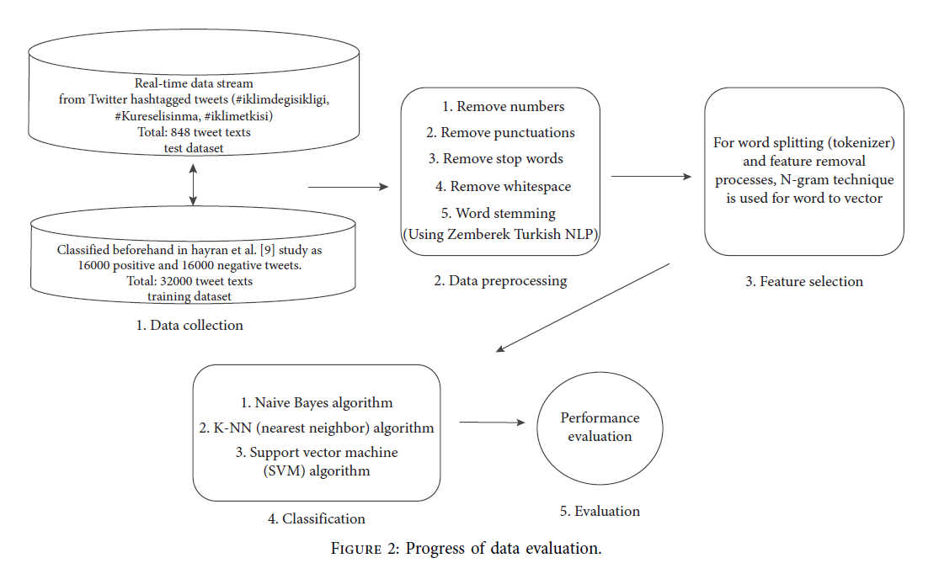
3
Method:

Slide 14
3
Results and/or Projections:
Using integrated classification methods instead of a single machine learning technique increased the success rate of accuracy
Considering the high rate of double or triple word groups in Turkish language, it is recommended to choose this integrated method in emotion classification studies
Using word splitting (tokenizer) in the phase of data preprocessing, “Zemberek” library for finding word roots and recommended integrated solution as N-gram for the feature removal process by using K-NN classification algorithm increased success rates
Data and Code Availability:
Coding material, couldn’t find
Data – All the raw data will be made available if needed

Slide 15
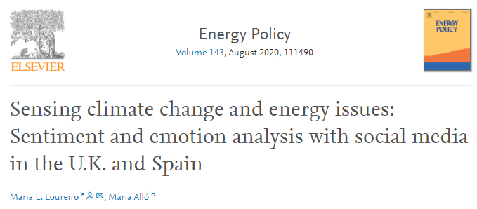
Additional Terms/Ideas/Perspectives (1/9)
Physical climate costs perspective [Podcast link] - unknown, very complex to predict
Transition climate costs - relatively known and under control
Exploring the potential of Physical climate costs - e.g. US southern border migration mainly because of consistent hurricane seasons one after the other in last four years
Consumer sentiment perspective; [Podcast link]
How Data Can Shift Consumer Sentiment? - Consumer psychology, if shown better data and transparency, are comfortable to buy things which are climate friendly
Developed vs Emerging markets perspective;
How far are the concerns lagging or how big is
the difference?

Slide 16

Additional Terms/Ideas/Perspectives (2/9)
Simply a “change” perspective;
This research paper is based only on in-person Interviews with officials and researchers in Canada
Key highlights:
• Sentiments expressed around “change” revealed drivers and barriers to change
• Most positive sentiments found in institutional changes e.g., horizontal integration
• Positive changes were also linked to local govt. leadership & staff quality
• Important negative sentiments were stated about the scale & pace of change
• Behavioural change is deemed as a barrier and thus negative by local govt officials

Slide 17

Additional Terms/Ideas/Perspectives (3/9)
Events based perspective, pre-post study;
To examine whether “climate change sentiment” changes in response to five separate natural disasters occurring in the U.S. in 2018
Applied RNNs to conduct a cohort-level analysis showing that the 2018 hurricanes yielded a statistically significant increase in average tweet sentiment affirming climate change

Slide 18
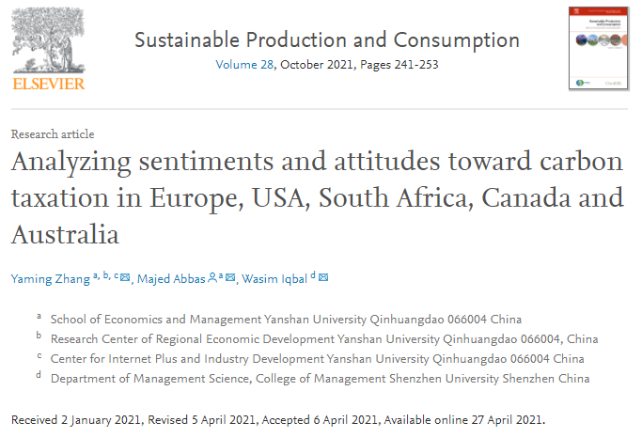
Additional Terms/Ideas/Perspectives (4/9)
Another perspective;
Focussing on a single facet of climate change

Slide 19
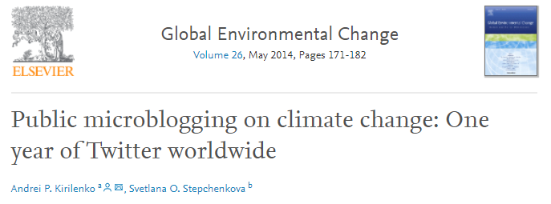
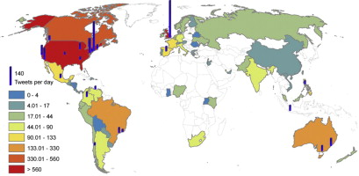
Additional Terms/Ideas/Perspectives (5/9)
In 2012 and 2013, the authors collected 1.8m tweets on “climate change” and “global warming” in five major languages (English, German, Russian, Portuguese, and Spanish).
The paper discusses the geography of tweeting, weekly and daily patterns, major news events that affected tweeting on climate change, changes in the central topics of discussion over time, the most authoritative traditional media, blogging, and the most authoritative organizational sources of information on climate change referenced by Twitter users in different countries.

Slide 20
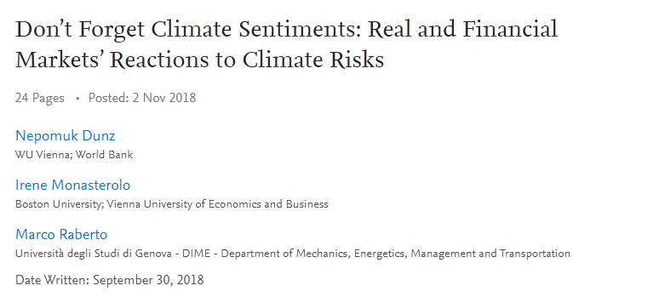
Additional Terms/Ideas/Perspectives (6/9)
This paper contributes to the discussion on what role could green fiscal, monetary policies and financial regulation play in the sustainability agenda.
Simulated and compared five scenarios characterized by different types of phasing in of government’s climate policies, which are represented by a carbon tax implemented according to the recommendations of Stiglitz and Stern (2017), and by different levels of real and financial market’s reactions to climate physical and transition risks, i.e. what they call “climate sentiments”

Slide 21

Additional Terms/Ideas/Perspectives (7/9)
Don’t have direct access to the article
Latent Dirichlet Allocation was applied for topic modeling to infer the different topics of discussion, and Valence Aware Dictionary and sEntiment Reasoner was applied for sentiment analysis to determine the overall feelings and attitudes found in the dataset.
These techniques are used to compare and contrast the nature of climate change discussion between different countries and over time.

Slide 22

Additional Terms/Ideas/Perspectives (8/9)
Don’t have direct access to the article
David Wallace-Wells’ New York Magazine article describing the possible devastating impacts of climate change has reignited an increasingly heated debate among researchers, advocates, and commentators over the pros and cons of ‘doom and gloom’ messaging in climate change communications
Some prominent scientists have pushed back against the article in part arguing that such pessimistic coverage depresses and demoralizes the public into further inaction

Slide 23

Additional Terms/Ideas/Perspectives (9/9)
News media vs Social media perspective;
How the two mediums interact with/influence each other when it comes to climate change and what are its implications for policy and decision makers?

Slide 24



Data Sources & APIs
5
Major Social Media platforms checked; Twitter, Reddit, Facebook, Tumblr, Instagram, Quora, Pinterest
Facebook has an API but there are a lot of user permissions related issues
Instagram and Pinterest are majorly Image/Video based platforms, so not in our current scope
Quora, very rich dataset but unfortunately no straightaway API to parse the historical content
which leaves us with below three (text/image/video based platforms);

Slide 25
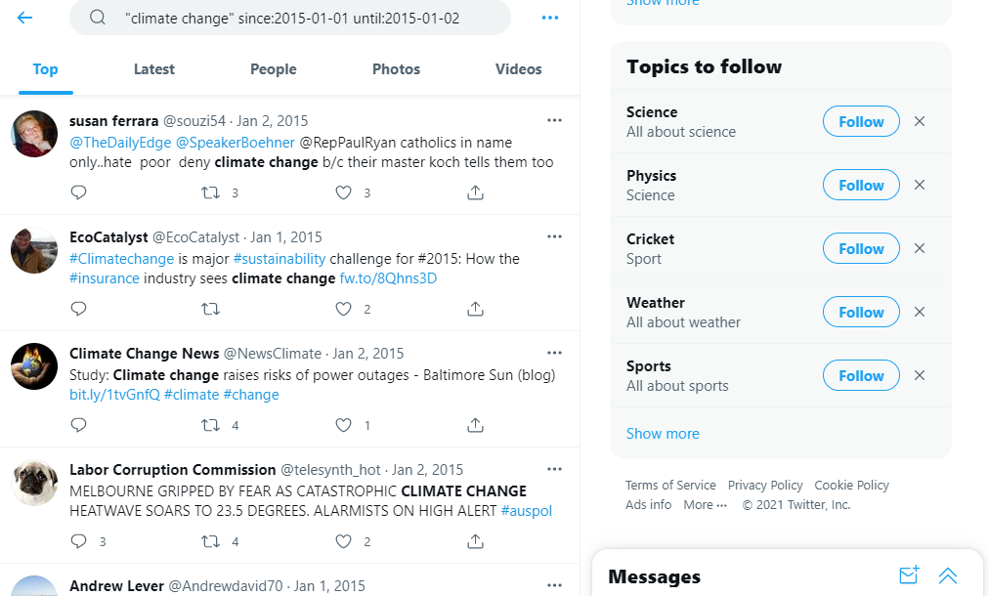
Data Sources & APIs
5
Twitter - Live streaming API available; all kind of information including text, geographic location, number of followers, retweets etc. can be collected. But can only collect MAX 30 days in history
- Older tweets with High frequency – may cost a lot of money! can only be bought from different companies or Twitter directly!
- Alternative: Use browser-based-search and scrape the tweets:
“near”, “lang” & “geocode” parameters to specify Location and Language e.g. near:Paris, lang:fr, geocode:40.712776,-74.005974,10km
Drawback: Limit of 500 random tweets per query search
But Timestamps can be managed granularly with nanoseconds precision, so building a large dataset is possible, but it’ll be relatively very time consuming due to Browser-based-interaction!
Location is tricky to handle! Gridmaps with radius etc.

Slide 26
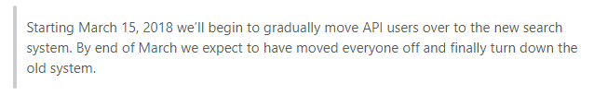
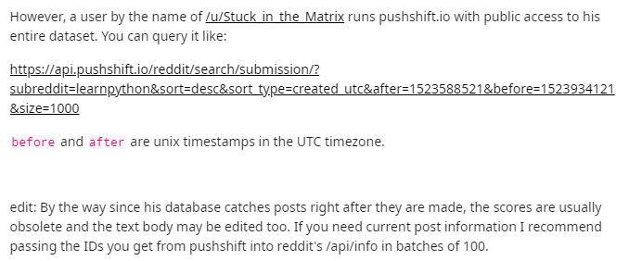
Data Sources & APIs
5
Reddit – again streaming APIs available; PRAW, reddit API etc.
Here also Timestamps can be managed granularly with nanoseconds precision, so building a large dataset is possible!
However, it lacks Location variable and post information may not be updated!
Good thing, the subreddits/communities have predefined protocols and motivations, so content is strictly context specific!

Slide 27
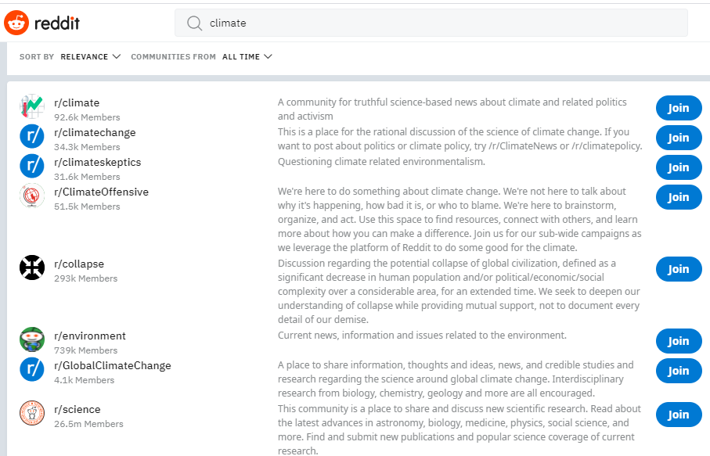
Data Sources & APIs
5
Reddit: examples of some Climate based subreddits/communities;

Slide 28
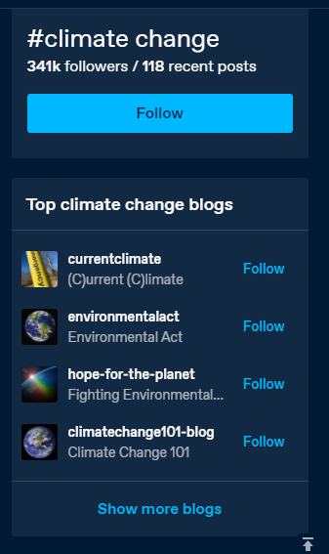
Data Sources & APIs
5
Tumblr. - streaming API available; Tumblr API, pytumblr
Specific #tags such as “#climate change” or blogs such as “(C)urrent (C)limate” can be identified and scraped based on Timestamps/Count iterations
Lacks location specific data!
Provides both context specific content like Reddit via blogs, and generic content like twitter via #tags
However, I’ve not used it much, so not sure how rich data-source it really is!

Slide 29

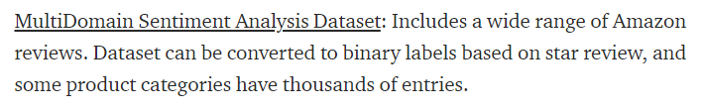

Additional Datasets
5
Sentiment140 dataset for Tweets classification – I’ve a Jupyter notebook already hosted on Kaggle with CNN based classifier on TPU (c.200x faster training than CPU), so basically the pipeline is ready! (does not have a “neutral” class though)
All news articles from 10 major English newspapers in India published from 2000-2020 – personally collected, available in PostgreSQL database and csv format
General text based datasets; https://medium.com/@ODSC/20-open-datasets-for-natural-language-processing-538fbfaf8e38

Slide 30
THANK YOU

